Slide 1

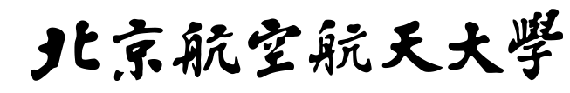
BEIHANG UNIVERSITY
Reasoning for MDLLMs
2025.12.10
李海军

Slide 2
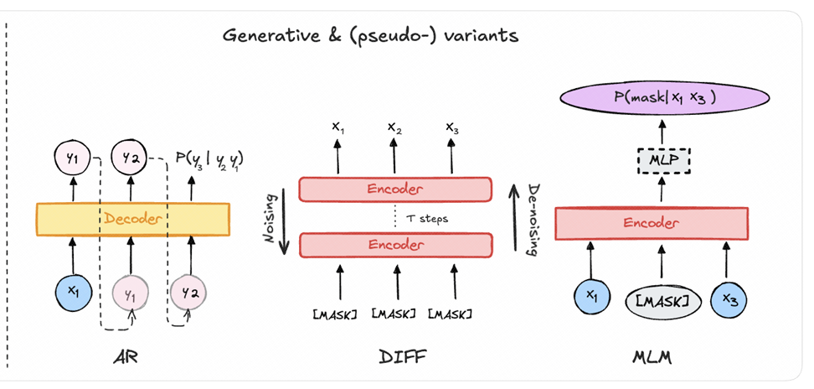

MLM&AR (BERT) vs DIFF
BEIHANG UNIVERSITY
Think about AR and Diffusion🤔?
BERT 是 bidirectional;
GPT 是 autoregressive；
[1] Generative or Discriminative? Revisiting Text Classification in the Era of Transformers. EMNLP-main 2025
JUNE 12th

Slide 3
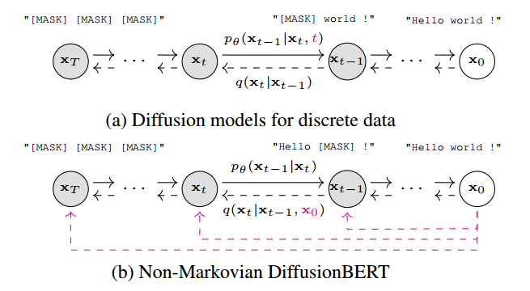
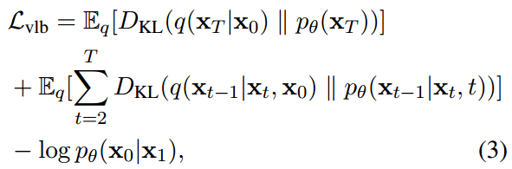
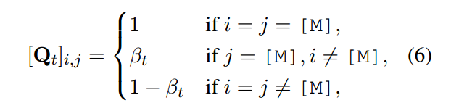
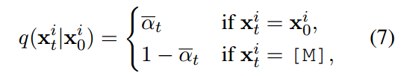
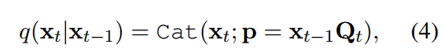
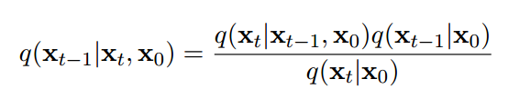
DiffusionBERT
BEIHANG UNIVERSITY
怎么把BERT变成一个生成模型？（扩散模型的加噪就是MLM）
由于没有时间步，BERT无法记录前向加噪规则
传统加噪可能将token替换为词表任意token，而不是[Mask]
DiffusionBERT的改进：
每一步都从原始文本x₀重新随机mask，通过控制mask ratio来模拟不同时间步的加噪。(加噪不在依赖前一步，而是原始文本)
总损失函数：
形式化为：
[1] DiffusionBERT: Improving Generative Masked Language Models with Diffusion Models. ACL 2023
JUNE 12th
Notes:
每步噪声后得到都是“bert可理解的文本 + MASK”，保留了BERT的原生能力，

Slide 4
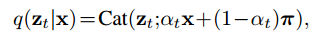
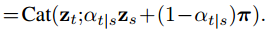
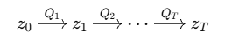
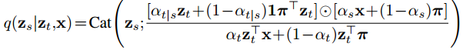
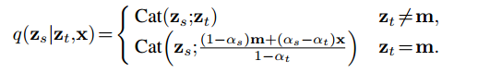
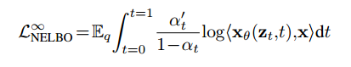
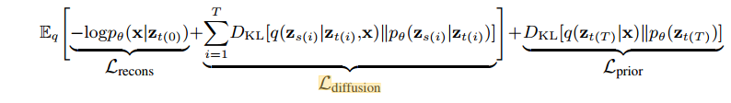
Masked Diffusion Large Language Models
BEIHANG UNIVERSITY
Diffusion:1.forward;2.reverse
formula
π
m
mask
Masked diffusion
Diffusion loss
[1] Simple and Effective Masked Diffusion Language Models. NeurPS 2024
JUNE 12th
Notes:
retention probability
只定义一条噪声 schedule：αt​=P(zt​=x)
最大似然估计 MLE 和 最小化 KL 散度

Slide 5
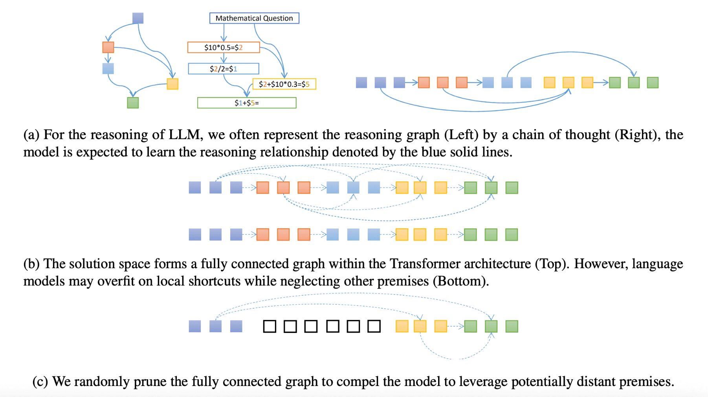
Masked Thought
BEIHANG UNIVERSITY
动机：随机掩蔽思维链中的某些token来提高模型推理（噪声和mlm任务）。
[1] Masked Thought: Simply Masking Partial Reasoning Steps Can Improve Mathematical Reasoning Learning of Language Models. ACL 2024 main
JUNE 12th
Notes:
Masked Thought: Simply Masking Partial Reasoning Steps Can Improve Mathematical Reasoning Learning of Language Models

Slide 6
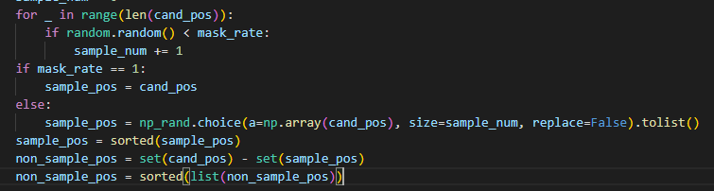
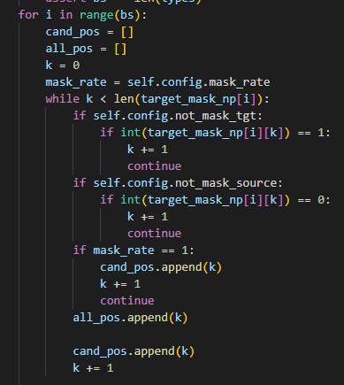
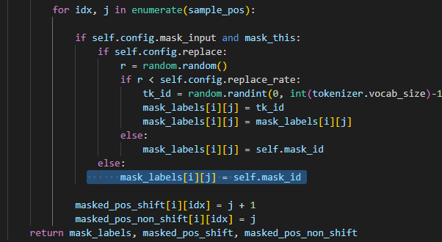
Masked Thought
BEIHANG UNIVERSITY
实现：
[1] Masked Thought: Simply Masking Partial Reasoning Steps Can Improve Mathematical Reasoning Learning of Language Models. ACL 2024 main
JUNE 12th
Notes:
Masked Thought: Simply Masking Partial Reasoning Steps Can Improve Mathematical Reasoning Learning of Language Models

Slide 7
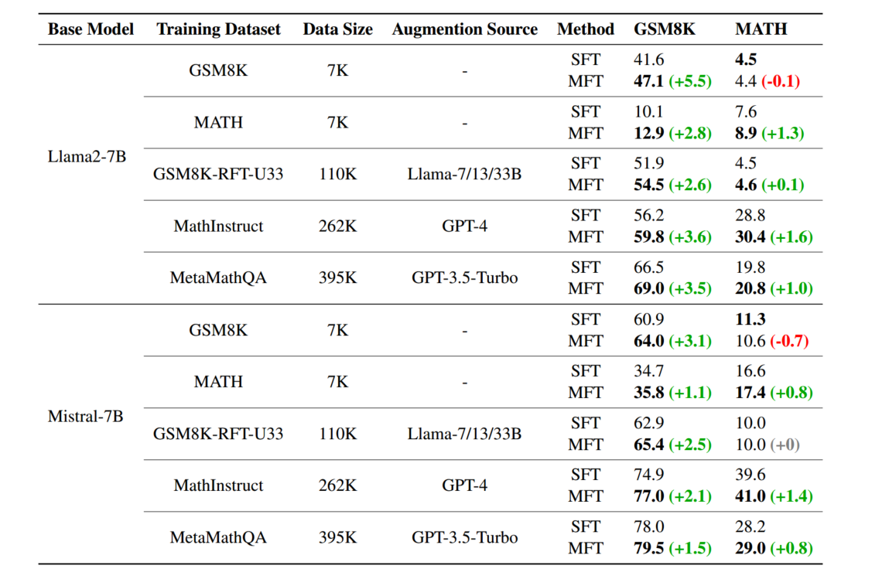
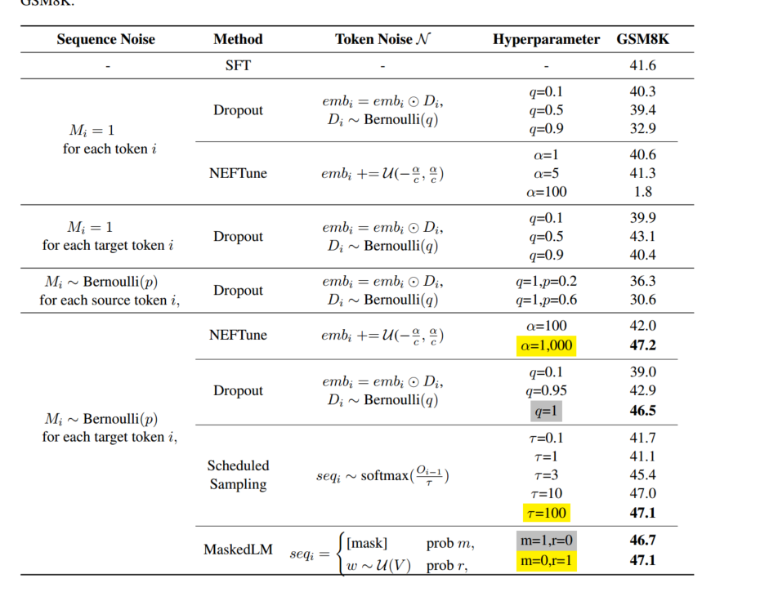
Masked Thought
BEIHANG UNIVERSITY
实验结果：
对于添加噪声的位置是否应该加以约束？
[1] Masked Thought: Simply Masking Partial Reasoning Steps Can Improve Mathematical Reasoning Learning of Language Models. ACL 2024 main
JUNE 12th
Notes:
Masked Thought: Simply Masking Partial Reasoning Steps Can Improve Mathematical Reasoning Learning of Language Models

Slide 8
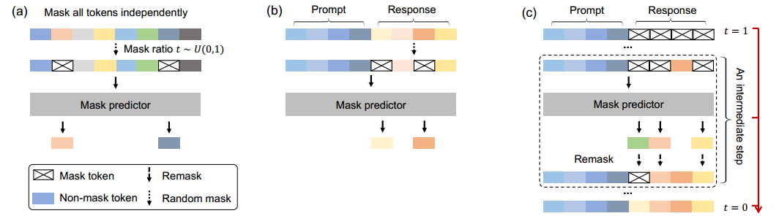
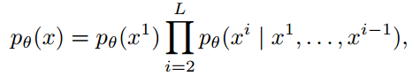
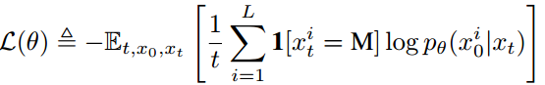
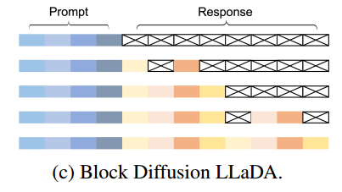
Large Language Diffusion Models
BEIHANG UNIVERSITY
Overviews
Autoregressive LLMs
Masked diffusion LLMs
Pretrain.
SFT.
Inference.
[1] Large Lanquage Diffusion Models. NeurPS 2025 Oral
[2] MaskGIT: Masked Generative Image Transformer. CVPR 2022
JUNE 12th
Notes:
MaskGIT: Masked Generative Image Transformer

Slide 9
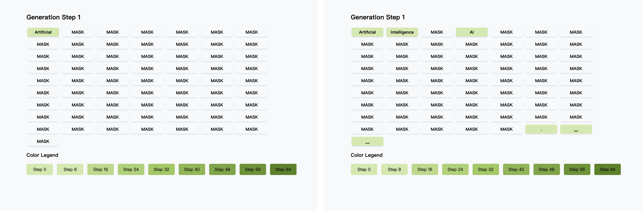
Large Language Diffusion Models
BEIHANG UNIVERSITY
示例
JUNE 12th
Notes:
MaskGIT: Masked Generative Image Transformer

Slide 10
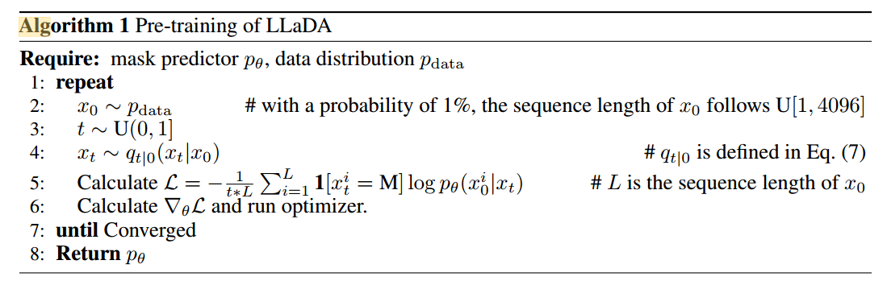
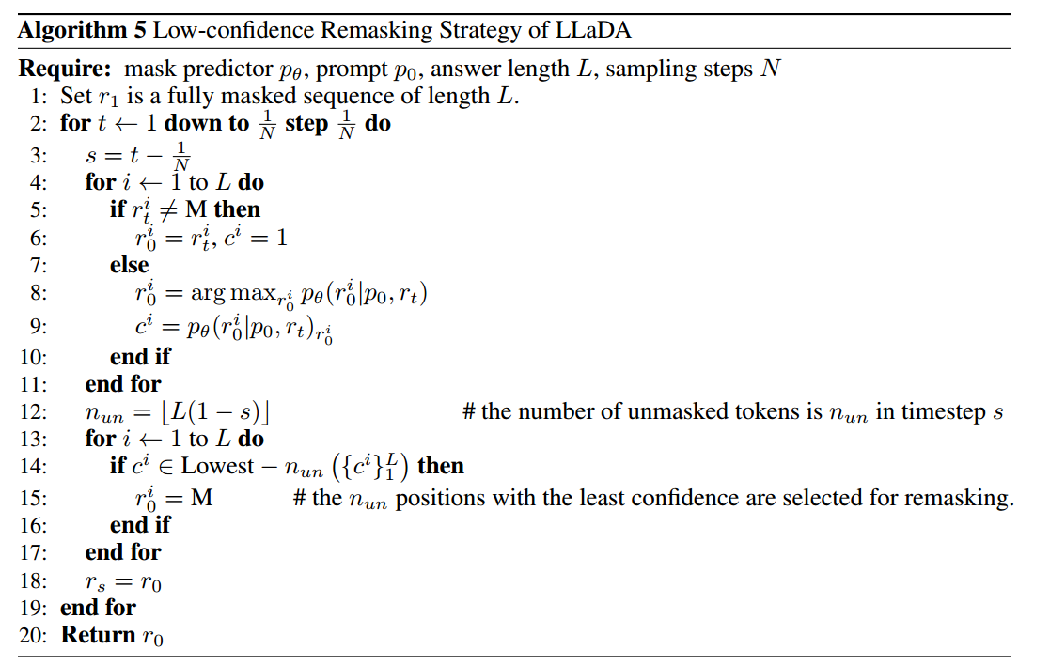
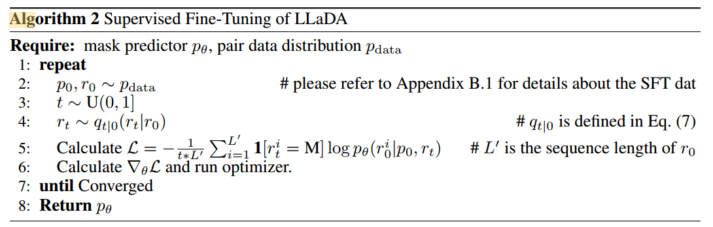
Large Language Diffusion Models
BEIHANG UNIVERSITY
Overviews
Think about AR and Diffusion🤔?
[1] Large Lanquage Diffusion Models. NeurPS 2025 Oral
[2] MaskGIT: Masked Generative Image Transformer. CVPR 2022
JUNE 12th
Notes:
MaskGIT: Masked Generative Image Transformer

Slide 11
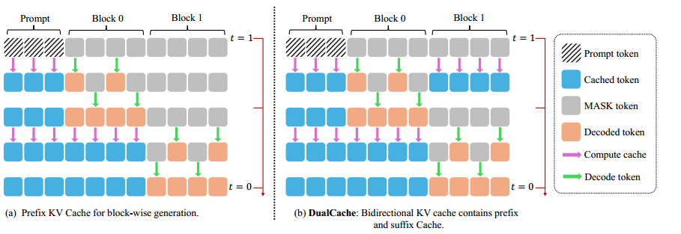
Fast-DLLM
BEIHANG UNIVERSITY
dLLM推理速度略低于AR-LLM？
缺乏KV Cache
并行解码多个 block 时生成质量下滑, 还是执行从左至右生成。
Fast-DLLM的改进：
提出block-wise approximate KV Cache技术，对于prompt、完全没解码和已解码的块将前一步的kv缓存近似为当前kv缓存。
对每个token计算一个置信度，仅对超过某阈值的 token 解码，其余保持 mask状态等待后续解码。
[1] Fast-dLLM: Training-free Acceleration of Diffusion LLM by Enabling KV Cache and Parallel Decoding. ICLR 2026 (8,8,6,6)
JUNE 12th
Notes:
d1: Scaling Reasoning in Diffusion Large Language Models via Reinforcement Learning

Slide 12
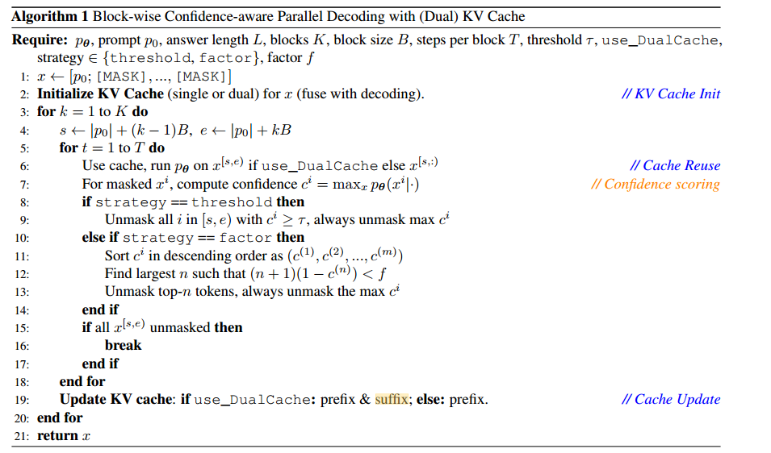
Fast-DLLM
BEIHANG UNIVERSITY
Fast-DLLM的block-wise approximate KV Cache伪代码。
[1] Fast-dLLM: Training-free Acceleration of Diffusion LLM by Enabling KV Cache and Parallel Decoding. ICLR 2026 (8,8,6,6)
JUNE 12th
Notes:
d1: Scaling Reasoning in Diffusion Large Language Models via Reinforcement Learning

Slide 13
Fast-DLLM & d1
BEIHANG UNIVERSITY
总结：
1.DLLM本身的训练工程。
2.DLLM的加速,开发高效的解码策略。
3.DLLM和RL结合的改善。(d1)
[1] Fast-dLLM: Training-free Acceleration of Diffusion LLM by Enabling KV Cache and Parallel Decoding. ICLR 2026 (8,8,6,6)
[2] d1: Scaling Reasoning in Diffusion Large Language Models via Reinforcement Learning. NeurPS 2025
JUNE 12th
Notes:
d1: Scaling Reasoning in Diffusion Large Language Models via Reinforcement Learning

Slide 14




BEIHANG UNIVERSITY
汇报结束 感谢聆听！

